Slide 1


FINANCIAL AID
GETTING HELP PAYING FOR COLLEGE

Slide 2


ABOUT LOSFA
The Louisiana Office of Student Financial Assistance (LOSFA) is a Program of the Louisiana Board of Regents, that strives to be Louisiana’s first choice for college access by promoting, preparing for and providing equity of college access. LOSFA administers the state’s scholarship and grant programs and the state’s Internal Revenue Code Section 529 college savings programs.

Slide 3

TYPES OF FINANCIAL AID
Scholarships
    Gift Aid – Based on Merit
Grants
    Gift Aid – Based on Need
Employment Opportunities
    May be based on need
Loans
    Must be repaid – may be based on need

Slide 4
BASIS OF AID
Merit-based aid is based on a student’s academic achievement, grades, ACT/SAT scores, talent, ability, athletic achievement, etc.
Need-based aid is based on the student’s financial need

Slide 5
FINANCIAL NEED
Cost of Attendance (COA)
  Tuition and fees
  Room and board
  Books and supplies
  Transportation
  Miscellaneous personal expenses

Slide 6
SOURCES OF FINANCIAL AID
Federal Government
Institution
Military
Private
State of Louisiana

Slide 7


FEDERAL AID

Slide 8
FORMS
FAFSA®
    Required for all federal need-based aid programs
Institutional Data Form
    Many institutions require this form to gather information on student preferences and interest in specific programs
CSS Profile
    Some private institutions use this form to gather additional financial information
Verification Forms
  The verification process ensures that the information submitted on a student’s FAFSA® is correct and will involve submitting documents to the college’s financial aid office.

Slide 9
CHANGES TO THE 2024-25 BETTER FAFSA®
The release of the 2024-2025 FAFSA® will be delayed.
  The 2024-2025 FAFSA® will not be released until December; the exact date is unknown.
Streamlining the FAFSA® Form
  Eliminates the number of questions from 108 to 36
  Federal Student Aid (FSA) will receive federal tax information directly from the Internal Revenue Service (IRS)
FSA ID will need to be matched with the Social Security Administration before it can be used to access or start a FAFSA®.
  The current process has allowed individuals to use their FSA ID to file a FAFSA® while the match was taking place. This will no longer be the case starting with the 2024-2025 FAFSA®.
  The matching process will take 1-3 days.

Slide 10
CHANGES TO THE 2024-25 BETTER FAFSA®
Important Changes Coming to the 2024-25 Better FAFSA®
The FAFSA® will be a roles-based form.
  Students will only see questions that they need to answer as a student.
  For dependent students, a parent will need to log in to see the questions related to their role as a parent. (They will not see the student questions.)
  Whoever starts the FAFSA® first will need to identify the “contributors” (other people who need to provide information on that FAFSA®). It will be critical that the contributor’s information matches the information on the contributor’s Social Security card to prevent issues logging into the FAFSA®.
The Student Aid Index (SAI) will replace the Expected Family Contribution (EFC).

Slide 11
CHANGES TO THE 2024-25 BETTER FAFSA®
Applicants and other contributors must consent to the use of their Federal Tax Information (FTI) on the FAFSA®.
  An applicant or contributor can enter income and tax data manually on the FAFSA®.
  The applicant will not be eligible for federal student aid until all required contributors provide consent.
The number of family members in college is no longer a factor in the needs analysis.
Pell Grant eligibility will be expanded.
  Pell Grant eligibility will be calculated based on the SAI (similar to how it has been based on the EFC) but will also be determined using Federal Poverty Tables, which take into account the family make-up, size, and income.

Slide 12
CHANGES TO THE 2024-25 BETTER FAFSA®
The definition of family size has changed to align with the number of individuals reported as dependents on the applicant’s (if independent) or applicant’s parents’ (if dependent) U.S. tax return.
  Applicants may update family size if it changes after filing the tax return.
Beginning with the 2024-25 award year, otherwise dependent students who indicate that they have unusual circumstances that prevent them from providing parent data will no longer receive a rejected application.
  These students will have their application processed with a provisional independent status.
  This will generate output documents with a provisional SAI and an estimate of federal student aid eligibility.
  Aid administrators will need to make a final determination on whether these students should receive a dependency override.

Slide 13
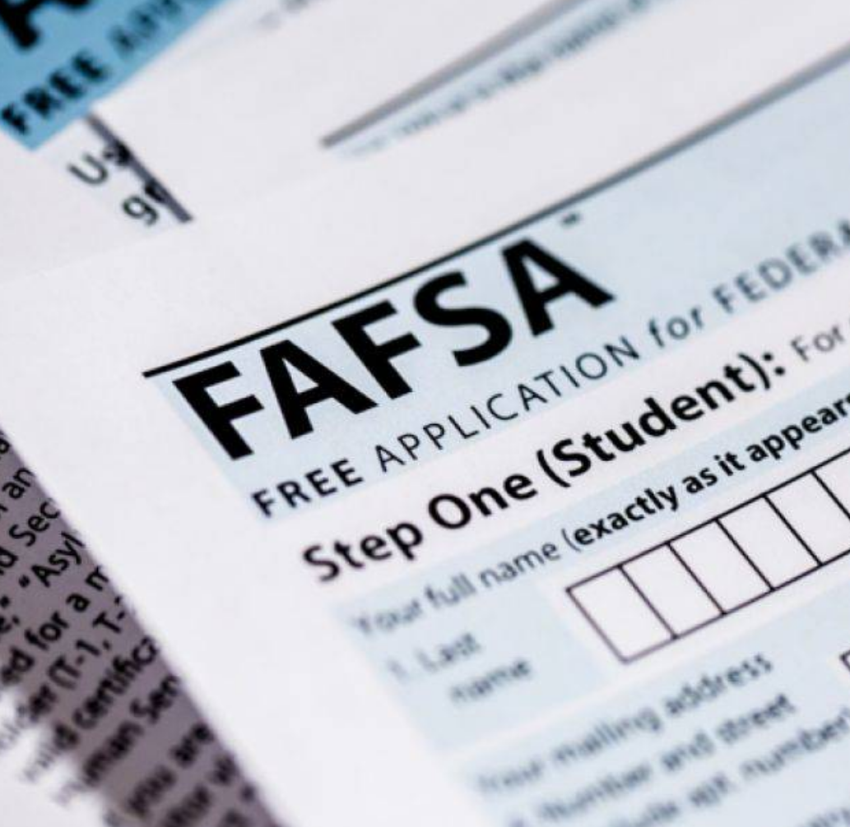
WHAT IS THE FSA ID?
The FSA ID (account username and password) allows students and parents to identify themselves electronically to access Federal Student Aid websites.
  FSA ID two-step verification will be required for everyone.
  Logging into a FAFSA® using student demographic information will no longer be possible.
  The student and parent must have different FSA IDs using separate email addresses and phone numbers.

Slide 14
FEDERAL STUDENT AID ELIGIBILITY
Be a U.S. citizen or an eligible non-citizen
Have a valid Social Security Number
Must have a high school diploma or its equivalent, or
  Complete a state approved home school program
  Pass an ability-to-benefit test
Maintain Satisfactory Academic Progress (SAP)
  Check with your school to determine its SAP standards

Slide 15
FEDERAL PELL GRANT
General Information
  Entitlement for students with substantial financial need
  Gift aid – does not have to be repaid
  Portable – can receive at any participating institution
  Eligibility is determined by the federal central processor when the FAFSA® is filed
  Maximum Annual Award: $7,395 (2023-24)
Eligibility Criteria
  Undergraduate students without a bachelor’s degree or first professional degree
  Must demonstrate exceptional financial need

Slide 16
CAMPUS-BASED FEDERAL AID
Eligibility is determined by the institution’s financial aid office for the following programs:
Children of Fallen Heroes Scholarship
Federal Supplemental Educational Opportunity Grant (FSEOG)
TEACH Grant
Iraq and Afghanistan Service Grant
Federal Work Study
William D. Ford Direct Student Loans

Slide 17

CHILDREN OF FALLEN HEROES SCHOLARSHIP
General Information:
Pell-eligible student whose parent or guardian died in the line of duty while performing as a public safety officer is eligible to receive a maximum Pell Grant for the award year for which the determination of eligibility is made.

Slide 18
CHILDREN OF FALLEN HEROES SCHOLARSHIP
Eligibility Criteria:
Student must be Pell-eligible and have a Pell-eligible SAI and be less than 24 years of age or enrolled at an institution of higher education at the time of his or her parent’s or guardian’s death.
In subsequent award years, the student continues to be eligible for the scholarship, as long as the student has a Pell-eligible SAI and continues to be an eligible student.

Slide 19
FEDERAL SUPPLEMENTAL EDUCATIONAL OPPORTUNITY GRANT (FSEOG)
General Information:
  Gift aid
  Maximum Award Amount: $4,000
  Apply by completing the FAFSA® annually
Eligibility Criteria:
  Undergraduate students without a bachelor’s or first professional degree
  Must demonstrate substantial financial need

Slide 20

TEACH GRANT
Teacher Education Assistance for College and Higher Education (TEACH) Grant
  Grants for undergraduate and graduate students who intend to teach full-time in high-need subject areas for at least four years at schools that serve low-income students
Maximum Annual Award Amount: $4,000
  Aggregate Undergraduate Limit: $16,000
  Aggregate Graduate Limit: $8,000
Institutions are not required to participate in this program

Slide 21
TEACH GRANT
Eligibility Requirements
Apply by completing the FAFSA® annually
  Not required to have financial need
Meet one of the following academic criteria:
  Score above the 75th percentile on a college admissions test (e.g., SAT, ACT, or GRE) or
  Graduate from high school with a cumulative GPA of at least 3.25 on a 4.0 scale to receive a grant as a freshman, or
  Have a cumulative college GPA of at least 3.25 to receive a grant for each subsequent term
Must complete TEACH Grant counseling
Sign a TEACH Grant Agreement to serve

Slide 22
TEACH GRANT
Teaching Obligation
Recipients must serve as a highly-qualified, full-time teacher in a high-need subject area for at least four years at a school serving low-income students
  mathematics;
  science, including, but not limited to, computer science;
  foreign language;
  bilingual education;
  English language acquisition;
  special education; or
  any other field that has been identified as high-need in the annual Teacher Shortage Area Nationwide Listing (Nationwide List) https://www2.ed.gov/about/offices/list/ope/pol/tsa.html
  Recipients must complete their teaching obligation within eight years of finishing the program for which they received the grant or repay the grant plus interest

Slide 23
IRAQ AND AFGHANISTAN SERVICE GRANT
You may be eligible to receive the Iraq and Afghanistan Service Grant if
you are not eligible for a Federal Pell Grant on the basis of your Expected Family Contribution but
meet the remaining Federal Pell Grant eligibility requirements, and
your parent or guardian was a member of the U.S. armed forces and died as a result of military service performed in Iraq or Afghanistan after the events of 9/11, and
you were under 24 years old or enrolled in college at least part-time at the time of your parent’s or guardian’s death.
Maximum award is equal to maximum Pell Grant amount

Slide 24
FEDERAL WORK STUDY (FWS)
Federal Work-Study provides part-time jobs for undergraduate and graduate students with financial need, allowing them to earn money to help pay education expenses. The program encourages community service work and work related to the student’s course of study.
General Information:
  Apply by completing the FAFSA® annually
  Eligibility determined by the institution’s financial aid office
  Wages must be not less than current minimum wage but may be more
  The amount you earn per academic year cannot exceed your total FWS award
  Employer may be the institution, a non-profit organization, or public agency
  Jobs at a non-profit organization or public agency must be related to the student’s major

Slide 25
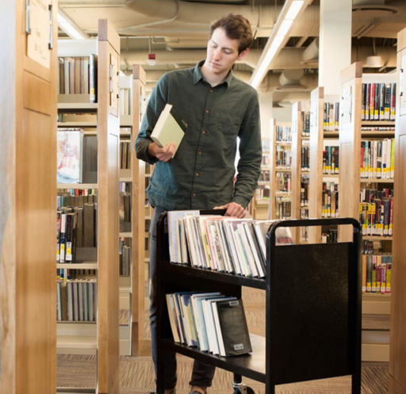
FEDERAL WORK STUDY (FWS)
Eligibility Criteria:
Undergraduate, graduate or professional students
  Includes less-than-half-time students
Must demonstrate financial need

Slide 26
WILLIAM D. FORD DIRECT LOANS
Direct Stafford Subsidized Loan
Direct Stafford Unsubsidized Loan
Parental Loans for Undergraduate Students (PLUS)
PLUS Loans for Graduate and Professional Students
Consolidation Loans

Slide 27
SUBSIDIZED LOAN
Loan is need-based
Must be enrolled at least half-time
Federal government pays all interest while:
  Borrower is in school
  During the grace period
  During periods of deferment

Slide 28
UNSUBSIDIZED LOAN
Loan is not need-based
Must be enrolled at least half-time
Borrower is responsible for interest at all times
  Borrower must elect to capitalize the interest or pay the interest while they are in school

Slide 29
PLUS LOANS
Eligible borrowers:
  Parent of a dependent undergraduate student
  Graduate or professional student
  Borrower must not have adverse credit
May borrow up to the Cost of Attendance less other aid received by the student
Loan is not need-based
Loan is unsubsidized
Loan goes into repayment when fully disbursed within 60 days
Student must be enrolled at least half-time

Slide 30
CONSOLIDATION LOANS
Available after you complete your education
Allows you to combine loans into a single loan
Allows you to reduce your monthly payments and extend your repayment period
The interest rate on the consolidation loan may be higher or lower than the interest rates of the individual loans

Slide 31
DIRECT LOAN LIMITS
Dependent Undergraduate Students
Borrower’s Academic Level | Combined Subsidized & Unsubsidized | Additional Unsubsidized | Total
Freshman | $3,500 | $2,000 | $5,500
Sophomore | $4,500 | $2,000 | $6,500
Remaining Undergraduate | $5,500 | $2,000 | $7,500

Slide 32
DIRECT LOAN LIMITS
Independent Students and Dependent Students Whose Parents Are Denied a Plus Loan
Borrower’s Academic Level | Combined Subsidized & Unsubsidized | Additional Unsubsidized | Total
Freshman | $3,500 | $6,000 | $9,500
Sophomore | $4,500 | $6,000 | $10,500
Remaining Undergraduate | $5,500 | $7,000 | $12,500

Slide 33
DIRECT LOAN LIMITS
Aggregate Loan Limits
Borrower’s Academic Level | Subsidized Limit | Aggregate Limit (Subsidized & Unsubsidized)
Dependent | $23,000 | $31,000
Independent Undergraduate | $23,000 | $57,500
Graduate or Professional (includes undergraduate amount) | $65,500 | $138,500
PLUS | Cost of Attendance | No federal limit
Notes:
Graduate and professional students are not eligible to receive Direct Subsidized Loans.

Slide 34
BORROWER RIGHTS & RESPONSIBILITIES
You may prepay your loans in whole or in part at any time without penalty
You must receive Entrance Counseling before receiving loan funds and Exit Counseling before leaving school
You will have a grace period of six months before your loan goes into repayment
  Begins the day after you graduate, withdraw from school, or drop below half-time status
  One grace period per loan
  Grace periods run concurrently

Slide 35
REPAYMENT OPTIONS
Standard Repayment Plan
  Up to 10-year repayment period
Graduated Repayment Plan
  Payments will increase over time
  Up to 10-year repayment period

Slide 36
REPAYMENT OPTIONS
Extended Repayment Plan
  Must have more than $30,000 in loans
  Fixed or graduated repayment for up to 25 years
Income-Based Repayment Plan (IBR)
  For borrowers who have a financial hardship
  Payments adjusted based on income during period of hardship
  Repayment period may exceed 10 years
  Loan cancellation for borrowers meeting certain requirements

Slide 37
REPAYMENT OPTIONS
Income Contingent Repayment Plan (ICR)
  Monthly payment will be the lesser of 20 percent of discretionary income, or the amount you would pay on a repayment plan with a fixed payment over 12 years, adjusted according to your income.
  Payments are recalculated each year
Income-Sensitive Repayment Plan
  Your monthly payment is based on annual income, but your loan will be paid in full within 15 years.

Slide 38
REPAYMENT OPTIONS
Saving on a Valuable Education (SAVE) Plan
  Monthly payments will be 10 percent of discretionary income and recalculated each year.
Pay As You Earn (PAYE) Plan
  Monthly payments will be 10 percent of discretionary income, but never more than you would have paid under the 10-year Standard Repayment Plan.

Slide 39
POSTPONING LOAN REPAYMENT
Deferment
A period of time where no payments are required
  Subsidized loans do not accrue interest
  Unsubsidized loans do accrue interest
Deferment Conditions
  If you are enrolled at least half-time
  Inability to find full-time employment (up to 3 years)
  Economic hardship (up to 3 years)
  Military active duty

Slide 40
POSTPONING LOAN REPAYMENT
Deferment Conditions
  If you are a parent who received a Direct PLUS Loan or a FFEL PLUS Loan, while the student for whom you obtained the loan is enrolled at least half-time.
  If you are enrolled in a graduate fellowship program
  While you are receiving cancer treatment and for six months following the conclusion of your treatment.
  While you are enrolled in an approved rehabilitation training program for the disabled.
  While you are experiencing economic hardship or serving in the Peace Corps, for up to three years.

Slide 41
POSTPONING LOAN REPAYMENT
Forbearance
A forbearance can allow you to temporarily reduce or suspend payments if you are not eligible for a deferment
  Interest accrues during the forbearance period
Forbearance Conditions:
  Financial difficulties
  Medical expenses
  Change in employment
  Other reasons acceptable to your loan servicer

Slide 42
DISCHARGE AND CANCELLATION
Your loan may be discharged if:
  You die
  You are totally and permanently disabled
  You are unable to complete your education because the school closed, falsely certified a loan, or fraudulently completed a loan application in your name
Bankruptcy generally does not result in the cancellation of a student loan

Slide 43
CONSEQUENCES OF DEFAULT
A loan is considered to be defaulted if you fail to make payments for 270 days
A defaulted student loan can result in:
  Damage to your credit rating
  Wage garnishment
  Denial of professional licenses
  Withholding of federal and state tax refunds
  Liability for collection costs and legal fees
  Referral of account to a collection agency
  Denial of access to student transcripts
  Loss of eligibility for future student financial aid

Slide 44

PRIVATE LOANS
A private student loan is a non-federal loan issued by a lender
  Private loans are often direct marketed to the student causing them to not apply for federal aid
  Private loans are also known as alternative loans
Private loans should only be used when all federal loan options have been exhausted

Slide 45
FEDERAL DIRECT LOANS & PRIVATE LOANS
  Federal Direct Loans
  You will not have to start repaying your Federal Student Loan until after you leave school or attend less than full-time
  The interest rate on a Federal Student Loan is fixed
  A student does not need to pass a credit check to get a Federal Student Loan
  You don’t need a co-signer
  Some interest is tax deductible
  Federal Student Loans may be consolidated into a Federal Consolidation Loan
Private Loans
Many private student loans require payments while you are still in school
Private loans can have variable interest rates greater than 18%
Private loans may require an established credit history and your credit score can determine your interest rate
You may need a co-signer to get the best deal
Interest may not be tax deductible
Private loans cannot be consolidated into a federal student loan

Slide 46
INSTITUTIONAL AID

Slide 47
INSTITUTIONAL AID
Each institution has its own merit-based scholarship programs
Many schools have their own need-based aid programs
Investigate aid opportunities early
  Each institution has its own aid application process and deadline
  Institutional websites list scholarship opportunities
Departmental Scholarships
  Scholarship opportunities for students in a specific major

Slide 48
PACKAGING
Packages are usually prepared for students who have been accepted for admission and have sent their FAFSA® data to the school
  The sum of all aid received cannot exceed the cost of attendance (COA)
Aid is typically packaged in the following order:
  Scholarships & Grants
  Work Study
  Student Loans

Slide 49
INSTITUTIONAL AWARD LETTER
The award letter will list all aid that the financial aid office has approved for the student
Institutions will typically include an estimate of a TOPS award in the financial aid package to prevent an over-award of other forms of financial aid
  Official notification of a TOPS award is made ONLY by LOSFA
Verify the method required to accept the award

Slide 50

MILITARY OPPORTUNITIES

Slide 51
MILITARY EDUCATIONAL OPPORTUNITIES
G.I. Bill
Education benefits for service members who have served on active duty for 90 or more days
  Up to 100% Tuition and Fee Coverage
  Monthly Living (Housing) Stipend
  Up to $1,000 a year for Books and Supplies

Slide 52
MILITARY EDUCATIONAL OPPORTUNITIES
ROTC Scholarships
  In exchange for a service commitment, the Reserve Officers' Training Corps (ROTC) scholarships pay for almost all tuition, fees and books charges for four years of college
Louisiana National Guard Tuition Exemption
  Waives the cost of tuition only for Louisiana Army and Air National Guard soldiers attending a Louisiana institution

Slide 53
MILITARY EDUCATIONAL OPPORTUNITIES
Louisiana National Guard Patriot Scholarship
Provides scholarships to Louisiana National Guard members who are enrolled in a Louisiana public postsecondary institution and who are eligible for the Louisiana National Guard tuition waiver.
This program provides for the payment of mandatory fees charged to the student by the institution as funds are appropriated.

Slide 54
PRIVATE AID

Slide 55
PRIVATE AID
The best source of information on private aid is the Internet. There are numerous free scholarship search services available
  See the Useful Links page on the LOSFA website or College Access on the Geaux for a listing of free scholarship searches.
Private aid can be based on merit or financial need
Providers of private aid include companies, civic organizations, religious organizations, clubs, etc.

Slide 56

LOUISIANA STATE AID PROGRAMS

Slide 57

LOUISIANA STATE AID PROGRAMS
Scholarships & Grants
TOPS Scholarship
Rockefeller State Wildlife Scholarship
GO Grant
Chafee Educational Training Voucher (ETV)
Regional Contract Program
M.J. Foster Promise Program
Geaux Teach
John R. Justice
Strategies to Empower People (STEP) Vocational Education Program

Slide 58

LOUISIANA STATE AID PROGRAMS
Louisiana Saving Programs
  START Saving Program
  LA ABLE Program
  START K12 Program
High School Opportunities
  TOPS Tech Early Start Program

Slide 59






CONNECT WITH LOSFA
Facebook
@losfa
Twitter
@losfa
YouTube
@losfa1000
Instagram
@losfa001
LOSFA also uses Signal Vine Text Messaging to connect with students and families. To receive important information and updates from LOSFA, sign up for Signal Vine by texting “LOSFA” to 56500.

Slide 60


CONTACT LOSFA
ON THE WEB
ASK
LEX
www.mylosfa.la.gov
custserv@la.gov
GeauxFAFSA®®@la.gov
VIRTUAL OFFICE HOURS
LEX is LOSFA’s virtual response assistant
LEX is available on LOSFA’s Website at www.mylosfa.la.gov
Available 24/7 to answer questions about LOFSA Programs
9:00 a.m. – 3:00 p.m.
Monday – Friday

Slide 61
QUESTIONS?
CUSTSERV@LA.GOV

Slide 62
DON’T BLOW YOUR TOPS
WHY IT PAYS TO MAKE GOOD GRADES

Slide 63
ABOUT LOSFA
The Louisiana Office of Student Financial Assistance (LOSFA) is a Program of the Louisiana Board of Regents, that strives to be Louisiana’s first choice for college access by promoting, preparing for and providing equity of college access. LOSFA administers the state’s scholarship and grant programs and the state’s Internal Revenue Code Section 529 college savings program.

Slide 64

TOPS
Please remember that:
Funding for TOPS is contingent upon appropriation.
For 2024 graduates, the Louisiana Legislature adjourns on June 3, 2024. LOSFA will know after the session ends if TOPS is fully funded.
If TOPS is not fully funded, TOPS Awards and stipends will be determined on a pro-rata basis.
Students can opt out of receiving a TOPS Payment(s) if the program is not fully funded.

Slide 65
TOPS AWARD AMOUNT
TOPS Award Amounts are set at the maximum TOPS “fully funded” amount as the tuition charged by the institution for the 2016-2017 academic year.
This amount will not increase even if the institution raises tuition, unless the Louisiana Legislature enacts legislation to raise the TOPS Award Amounts.
See TOPS Award Amount chart: https://mylosfa.la.gov/wp-content/uploads/Current-Year-TOPS-Funding.pdf

Slide 66

CITIZENSHIP
A student must be a
U.S. citizen, a permanent resident who is eligible to apply for citizenship, or a child of a non-citizen serving in the Armed Forces or honorably discharged from the Armed Forces.

Slide 67
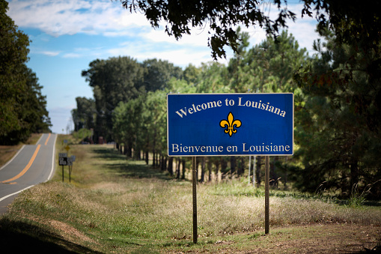
RESIDENCY
An independent student or a parent or court ordered custodian of a dependent student must have been a resident of the state of Louisiana and actually reside or live in Louisiana for the 24 months prior to high school graduation.
For 2024 graduates, residency must have been established no later than April 2022

Slide 68
TOPS OPPORTUNITY, PERFORMANCE AND HONORS
CORE CURRICULUM
For high school graduates of 2018 - 2026
  English – 4 Units
  Math – 4 Units
  Science – 4 Units
  Social Studies – 4 Units
  Foreign Language – 2 Units (same language)
  Art – 1 Unit
  Please visit our Website for more details

Slide 69
TOPS CORE CURRICULUM GPA
TOPS Core Curriculum Grade Point Average (GPA) is calculated on a 4.00-point scale, except the following designated courses that will use a 5.00-point scale:
  Advanced Placement (AP) courses
  International Baccalaureate (IB) courses
  Gifted courses
  Dual Enrollment courses
  Honors courses
  Articulated courses offered for college credit by the Louisiana School for the Math, Science and the Arts.
The courses currently designated to be calculated on the 5.00 point scale can be viewed at https://mylosfa.la.gov/wp-content/uploads/2019/05/TOPSCoursesApproved5Scale.pdf

Slide 70

ACT
Highest composite score from a single test will be considered
    TOPS does not consider the Essay portion of the ACT in calculating the composite score needed to qualify
    TOPS does not consider superscores
ACT Registration
    TOPS Code 1595
    Date of Birth

Slide 71
ACT
ACT Deadlines for 2024 Graduates
      Without penalty: April 13, 2024
      Loss of one semester eligibility: June 8, 2024 or July 13, 2024
        Special tests may be taken prior to July 31st
        A June or July ACT score can be used to upgrade TOPS Awards with a one semester or two quarter penalty
    Students who fail to achieve a qualifying ACT score by July 31st of the graduating year shall not be considered for an award
    TOPS uses the highest composite score achieved and does not use superscoring.

Slide 72
SAT
An equivalent SAT score may be substituted for the ACT score
    TOPS does not consider the Essay portion of the SAT in calculating the composite score needed to qualify
SAT Registration
    Scholarship Code 9019
SAT Test Deadlines
    Without Penalty: March 9, 2024
    Loss of 1-semester eligibility: May 4, 2024, and June 1, 2024

Slide 73

TOPS AWARD LEVELS
OPPORTUNITY AWARD
PERFORMANCE AWARD
HONORS AWARD
TECH AWARD

Slide 74
OPPORTUNITY AWARD ELIGIBILITY REQUIREMENTS
  2.50 minimum TOPS Core Curriculum GPA
  ACT score equal to the prior year’s state average, but never less than 20
      20 for 2024 graduates
      SAT Score of 1030
  Completion of the TOPS Core Curriculum
  TOPS general eligibility requirements

Slide 75
OPPORTUNITY AWARD BENEFITS
Provides a TOPS Award Amount or a portion of a TOPS Award Amount based on funds appropriated at a Louisiana public institution.
  Or a weighted average award amount at a LAICU private institution (contingent upon appropriations)
  TOPS does not cover any fees (Examples of fees may or may not include: academic excellence fees, energy surcharges, technology fees, books, room & board, parking fees, lab fees)
  A TOPS award may be combined with other forms of financial aid up to the “Cost of Attendance” for the institution

Slide 76
OPPORTUNITY AWARD BENEFITS
May be used to pursue:
    Academic undergraduate degree
    Vocational or technical certificate
    Non-academic degree
Students who use their Opportunity Award to pursue a technical program will receive the same benefits and be held to the same retention requirements as a TOPS Tech Award recipient
    The award may be used at eligible Louisiana cosmetology and proprietary schools

Slide 77
OPPORTUNITY AWARD BENEFITS
May be received for a maximum of eight semesters or 12 quarters
Not available for summer terms except for students enrolled in a Qualified Summer Session and contingent upon sufficient appropriation

Slide 78
OPPORTUNITY AWARD BENEFITS
Any recipient who successfully completes a Bachelor’s degree in less than 8 semesters or 12 quarters of award benefits, may receive any remaining terms of eligibility for graduate study
      The TOPS Award Payment for TOPS eligible students enrolled in a graduate/professional program is limited to the full tuition charged by a school for enrollment in the respective graduate program OR the maximum TOPS Award amount charged for undergraduate full-time enrollment at the highest cost public institution (LSU-HSC-NO), whichever is less
      Performance and Honors award recipients will receive their stipends

Slide 79
PERFORMANCE AWARD ELIGIBILITY REQUIREMENTS
  3.25 minimum TOPS Core Curriculum GPA
      ACT score of 23
      SAT score of 1130
  Completion of the TOPS Core Curriculum
  TOPS general eligibility requirements

Slide 80
PERFORMANCE AWARD BENEFITS
Provides the same benefits as the Opportunity Award, plus
$400 annual stipend (contingent upon appropriation)

Slide 81
HONORS AWARD ELIGIBILITY REQUIREMENTS
  3.50 minimum TOPS Core Curriculum GPA
      ACT score of 27
      SAT score of 1260
  Completion of the TOPS Core Curriculum
  TOPS general eligibility requirements

Slide 82
HONORS AWARD BENEFITS
Provides the same benefits as the Opportunity Award, plus
$800 annual stipend (contingent upon appropriation)

Slide 83
TOPS TECH AWARD ELIGIBILITY REQUIREMENTS
  2.50 minimum TOPS or TOPS Tech Core Curriculum GPA
      Minimum ACT score of 17
      SAT score of 920
      WorkKeys Silver Level Score
  Completion of one of two TOPS Core Curricula
      Opportunity, Performance or Honors Award curriculum
      TOPS Tech Jumpstart Core Curriculum

Slide 84
TOPS APPLICATION
    FAFSA (Free Application for Federal Student Aid) – www.studentaid.gov
    Must be completed if the student is eligible for federal grant aid (Pell Grant)
    Must be completed if the student is seeking any other form of financial aid
    The only application needed for TOPS

Slide 85
TOPS PROCESSING CYCLE
Transcript data is submitted by public school boards and non-public high schools to the Louisiana Department of Education (LDE) through the Student Transcript System (STS) after graduation
        Senior data must be received by LDE by June 15
        STS calculates the TOPS Core GPA and determines if the TOPS Core Curriculum has been met
LOSFA receives transcript data Monday – Friday.

Slide 86
TOPS PROCESSING CYCLE
TOPS award notifications are e-mailed each Friday
Award notifications are e-mailed to the e-mail address the student has in the Student Hub at www.mylosfa.la.gov
If the student has not registered for an account on the Student Hub, then the notification will be sent to the email address used on the FAFSA
The award letter includes the student’s Rights and Responsibilities
Students can check their status on the Student Hub
Students who have not received notification of their TOPS award eligibility by mid-July should contact LOSFA

Slide 87
AWARD ACCEPTANCE
Must enter an eligible institution as a full-time student by the fall semester following the first anniversary of high school graduation

Slide 88
AWARD ACCEPTANCE:
RETURNING OUT OF STATE STUDENTS
  Any TOPS eligible student who enrolls in an out of state institution may return to Louisiana and accept their TOPS award
  All Returning Out-of-State Students must meet the following:
      Must have met all TOPS continuation requirements that would have applied had the student been enrolled in an eligible in-state institution
      Must apply for award reinstatement by July 1 following the academic year in which the student returns to Louisiana
        Student awards will be retroactively paid for semesters attended in Louisiana if approved, provided they meet all continuation requirements.
        TOPS eligibility will be reduced by the number of semesters attended out of state

Slide 89
FAFSA
FREE APPLICATION FOR FEDERAL STUDENT AID

Slide 90
FAFSA
  The Free Application for Federal Student Aid (FAFSA) is the application for both federal and state aid programs.
        Be sure to fill out the FAFSA even if you don’t think you’ll qualify for need based aid.
  The FAFSA is the only application needed for the TOPS scholarship.
        Louisiana priority deadline is February 1
        Graduation requirement for public high school students.
  You should never be asked to pay to fill out the FAFSA. It is a FREE application.

Slide 91
BETTER FAFSA
Important Changes Coming to the FAFSA
The 2024-2025 FAFSA will be delayed.
  The 2024-2025 FAFSA will not be released until December; the exact date is unknown.
The Student Aid Index (SAI) will replace the Expected Family Contribution (EFC).
FSA ID will need to be matched with the Social Security Administration before it can be used to access or start a FAFSA.
  Currently, the process has allowed individuals to use their FSA ID to file a FAFSA while the match was taking place. This will no longer be the case starting with the 2024-2025 FAFSA.
  An FSA ID must be created and matched with the SSA before it can be used to start or access a FAFSA. The matching process will take 1-3 days.

Slide 92
WHAT IS THE FSA ID?
The FSA ID (account username and password) allows students and parents to identify themselves electronically to access Federal Student Aid websites.
  FSA ID two-step verification will be required for everyone.
  Logging into a FAFSA using student demographic information will no longer be possible.

Slide 93
BETTER FAFSA
Important Changes Coming to the FAFSA
The FAFSA will be a roles-based form.
  Students will only see questions that they need to answer as a student.
  For dependent students, a parent will need to log in to see the questions related to their role as a parent. (They will not see the student questions.)
  Whoever starts the FAFSA first will need to identify the “contributors” (other people who need to provide information on that FAFSA). It will be critical that the contributor’s information matches the information on the contributor’s Social Security card to prevent issues logging into the FAFSA.

Slide 94
BETTER FAFSA
Important Changes Coming to the FAFSA
Applicants and other contributors must consent to the use of their Federal Tax Information (FTI) on the FAFSA.
  An applicant or contributor can enter income and tax data manually on the FAFSA.
  The applicant will not be eligible for federal student aid until all required contributors provide consent.
The number of family members in college is no longer a factor in the needs analysis.
Pell Grant eligibility will be expanded.
  Pell Grant eligibility will continue to be calculated based on the SAI (similar to how it has been based on the EFC) but will also be determined using Federal Poverty Tables, which take into account the family make-up, size, and income.

Slide 95
BETTER FAFSA
Important Changes Coming to the FAFSA
The definition of family size has changed to align with the number of individuals reported as dependents on the applicant’s (if independent) or applicant’s parents’ (if dependent) U.S. tax return.
  Applicants may update family size if it changes after filing the tax return.
Beginning with the 2024-25 award year, otherwise dependent students who indicate that they have unusual circumstances that prevent them from providing parent data will no longer receive a rejected application.
  These students will have their application processed with a provisional independent status.
  This will generate output documents with a provisional SAI and an estimate of federal student aid eligibility.
  Aid administrators will need to make a final determination on whether these students should receive a dependency override.

Slide 96
CONNECT WITH LOSFA
@losfa
@losfa
@losfa1000
@losfa001
LOSFA also uses Signal Vine Text Messaging to connect with students and families. To receive important information and updates from LOSFA, sign up for Signal Vine by texting “LOSFA” to 56500.

Slide 97
QUESTIONS?
Email
Custserv@la.gov

